Slide 1
Team 7 Mothership Design
By: Ben Dolin, Elias Ghazal, Brad Lock,
Sarah Rasche, Sean Wan, Veronica Yapriadi

Slide 2
Placeholder: Outline

Slide 3
Placeholder: Schedule

Slide 4
Placeholder: Design Decisions

Slide 5
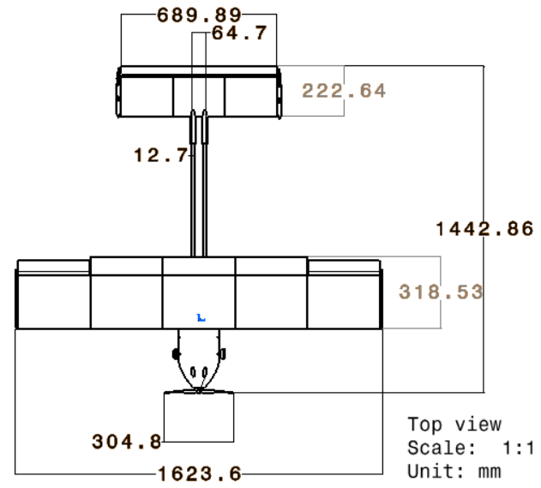
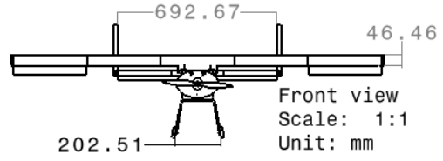
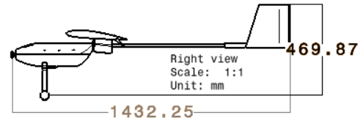
Walk around

Slide 6
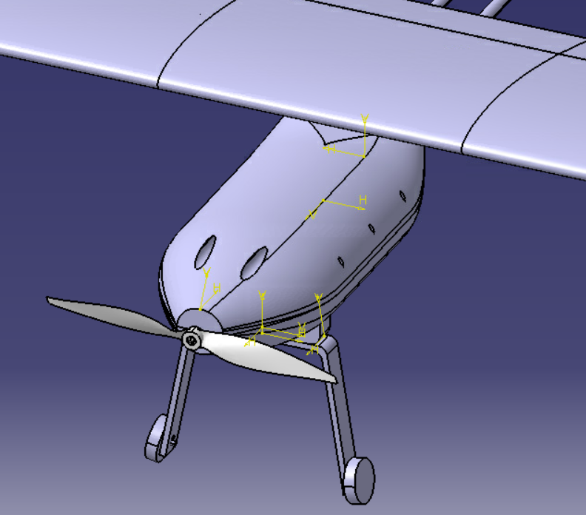
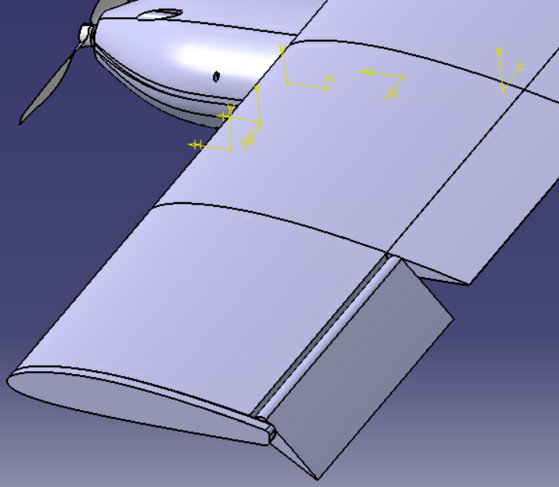
Walk around (cont.)
Easily-open fuselage contains electronics & propulsion system
Modular wings supported with spars
Custom landing gear with 1.5" Diameter Foam Wheel
APC 12x6 Propeller
Flaperon

Slide 7
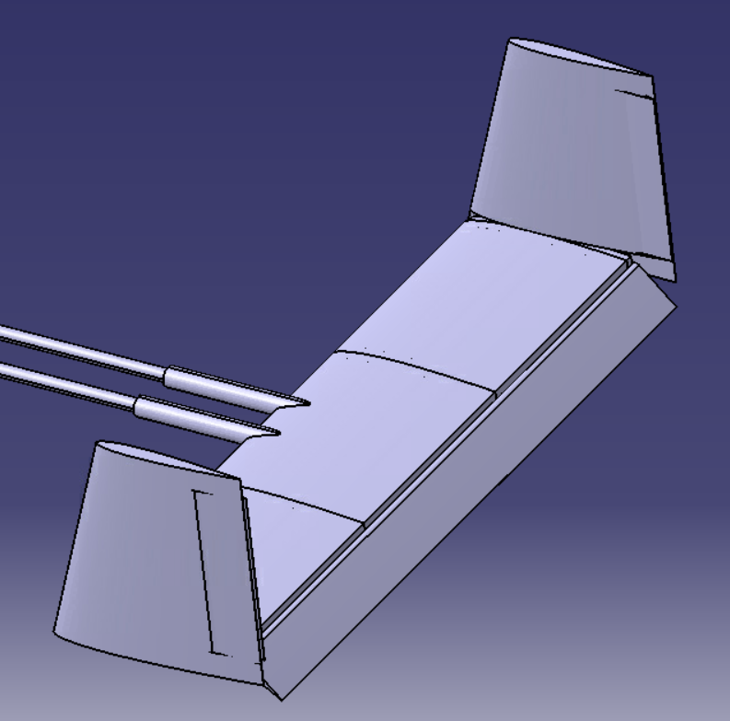
Walk around (cont.)
Insert
Combined Picture
With
Glider
H-tail with rudder and elevator controls

Slide 8
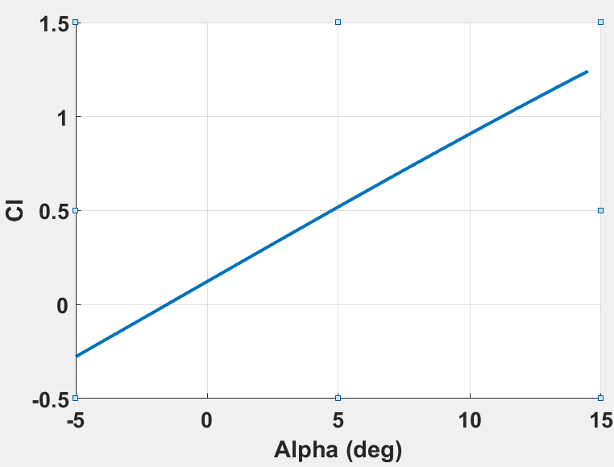
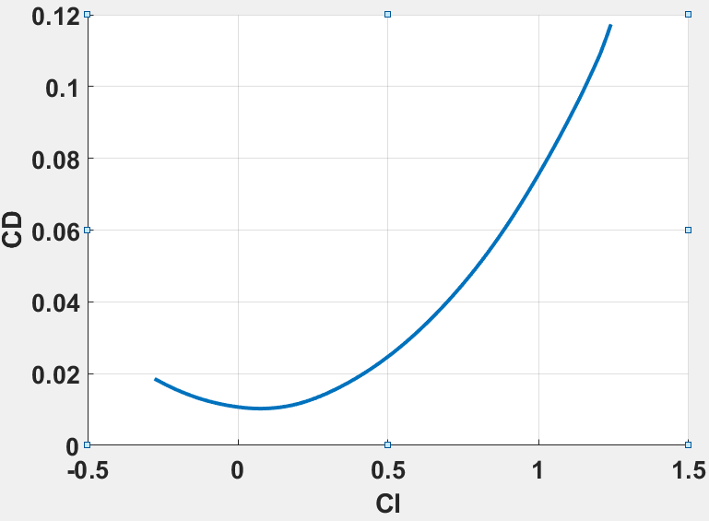
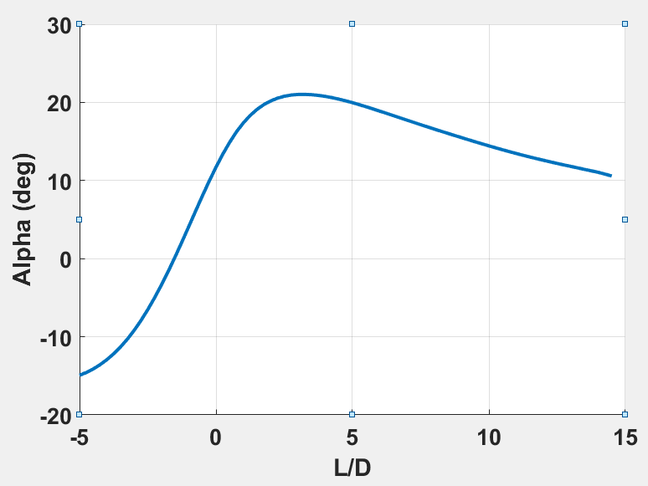
Aerodynamics
Cl max = 2.0
Cl cruise = .85
𝛼 = 8 degrees
Cd cruise = .05

Slide 9
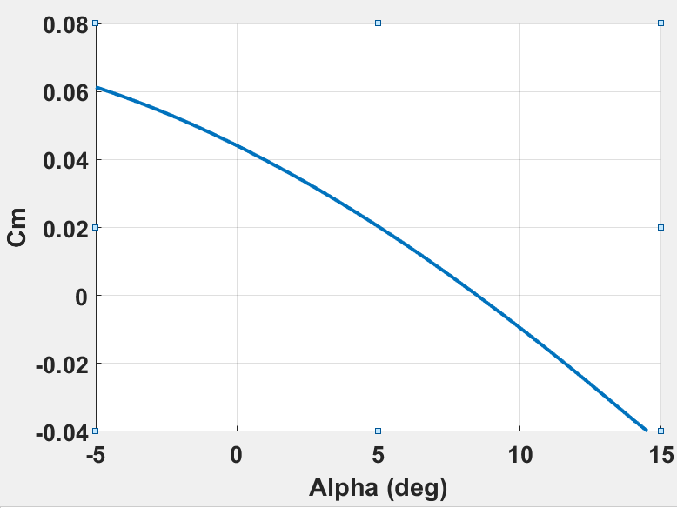
Dynamics and Controls
CXu = -0.07660
CLu = 0.00649
Cmu = 0.00000
CXa = 0.37110
CLa = 4.42922
Cma = -0.34752
CXq = 0.31505
CLq = 6.95617
Cmq = -12.19206
CYb = -0.18753
Clb = -0.00863
Cnb = 0.08919
CYp = 0.04034
Clp = -0.39494
Cnp = -0.12280
CYr = 0.20856
Clr = 0.18759
Cnr = -0.10034
Cm(8.5 deg) = 0 Cl(8.5 deg) = .8

Slide 10
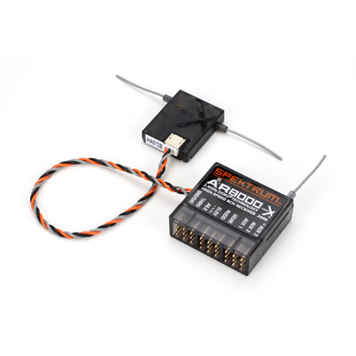
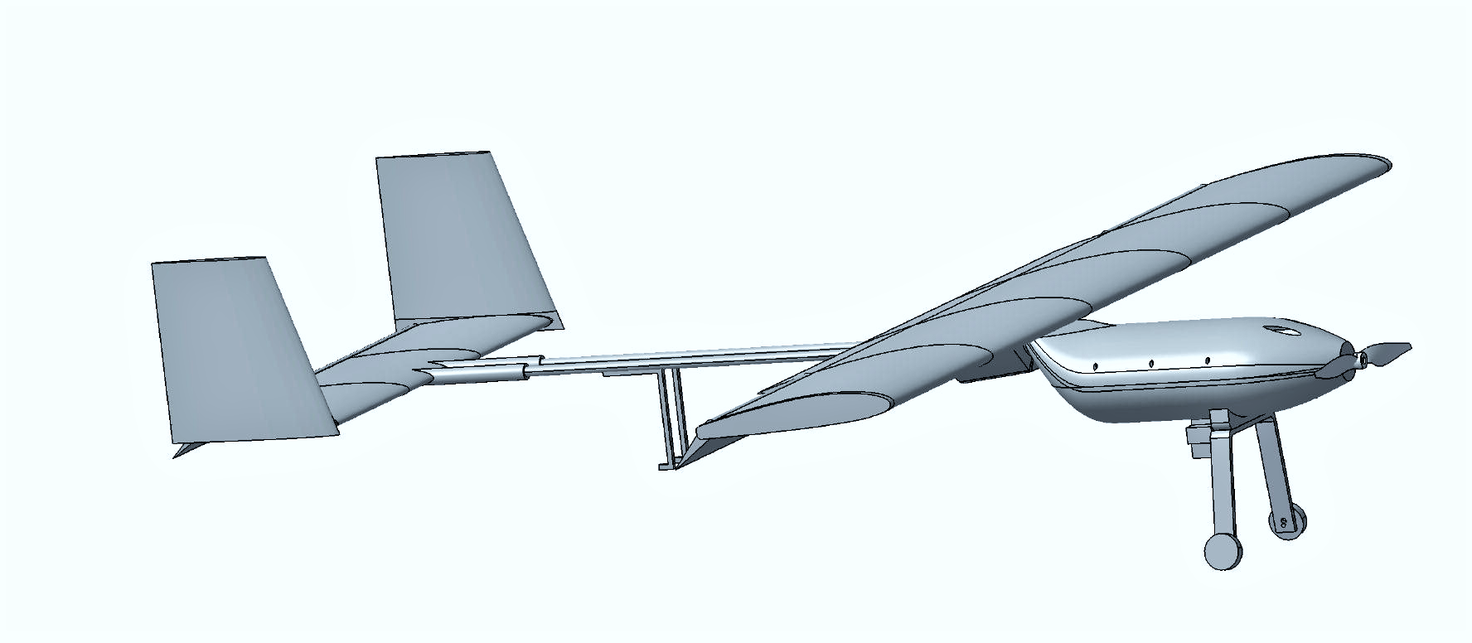

Feedback control system
Radio Control System
AR8000 8-Channel DSMX Receiver
Visual attitude feedback
Air Data from glider pitot tube before drop

Slide 11
Structures - Wing Box Characteristics
Wing Box Properties |  | Maximum Loads
Area (m²) | .63 | Maximum Bending Load (N) | 331.01
Skin thickness (mm) | 1.8 | Maximum Torsional Load (N) | 1.95
Width (m) | 0.3 | 𝜙_{max} (°) | 0.11
Height (m) | 0.036 | Maximum Wing Root Bending Moment (Nm) | 66
 |  | Maximum Wing Tip Vertical Deflections (cm) | 38.9
Notes:
Wing box for analysis assumed to be rectangular cross section to simplify analysis and estimate loads. PLA yield strength 35.9 MPa
https://www.sd3d.com/wp-content/uploads/2017/06/MaterialTDS-PLA_01.pdf
With a bank angle of 85 degrees the max stress experienced on the wing would be 7MPa, well within limits.

Slide 12
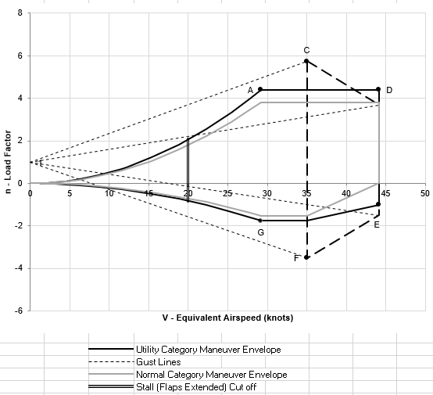
Structures - V-n Diagram
V_{speeds} | (m/s) | (kts)
V_{A} | 15 | 29.2
V_{C} | 18 | 35
V_{S1} | 10.28 | 20
V_{D} | 22.69 | 44.1

Slide 13
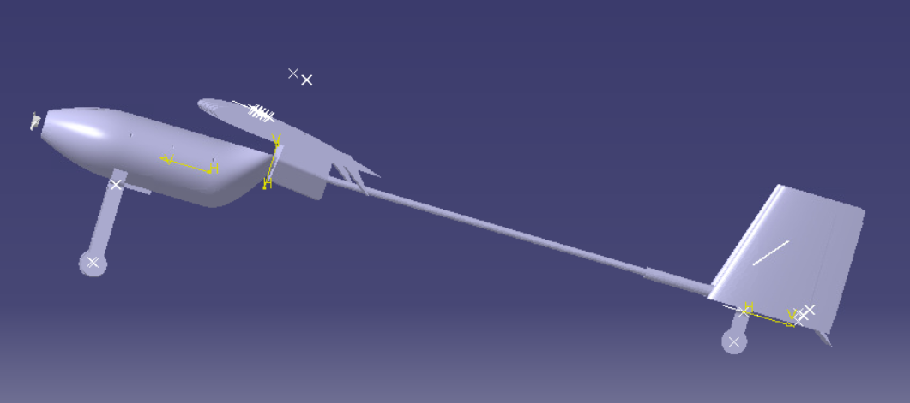
Landing gear
Configuration: Tail Dragger
Height: 12 cm
Width: 5 cm
Material: aluminium 5052
Bending radius: .5 cm
Tail down angle: 11 degrees

Slide 14
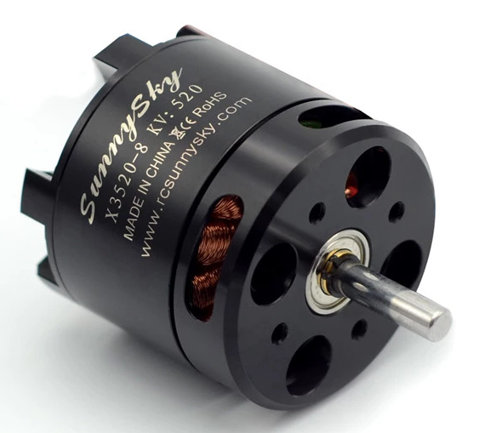
Propulsion - Electric Motor
Requirements:
Required thrust = 6.62N
Max. propeller rotation rate = 12,500 rpm
Selected: SunnySky X3520 Brushless Motor
Overview:
750 gf-thrust brushless motor
Can support up to 6s LiPo cell battery and ESC between 80 A to 100 A
Rated horsepower | 0.125 hp
Motor efficiency | 8.04 g/W
Motor Kv | 520
Rated voltage | 22.2
Rated number of cells | 4-6s
Weight | 207 g
Manufacturer | SunnySky USA

Slide 15
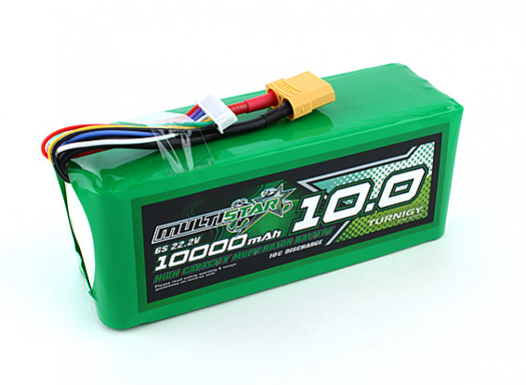
Propulsion - Battery
Number of Cells | 6S
Amp Hours | 10000 mAh
Volts | 22.2
Number of Batteries | 1
Weight | 1.189 kg
Height | 65 mm
Length | 156 mm
Width | 53 mm
Requirements:
Min. endurance = 20 minutes
Max. endurance = 27 minutes (under ideal conditions)
Selected: Multistar HighMultistar High Capacity 10000mAh 6S 10C Multi-Rotor Lipo Pack XT90

Slide 16
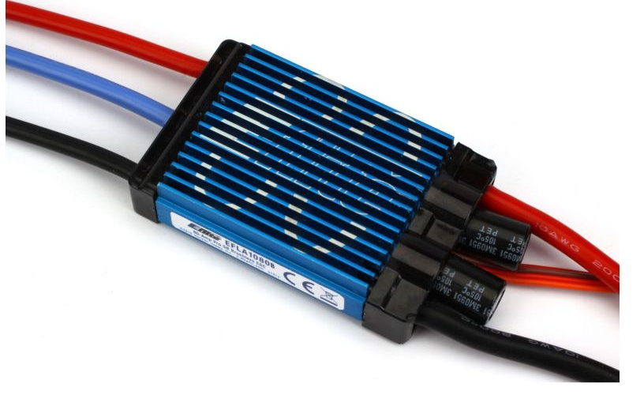
Propulsion - ESC
Selected: 80-Amp Pro Switch-Mode BEC
Brushless ESC, EC5 (V2)
Specifications:
Can take a 3-6 cell lithium polymer (LiPo) battery and draws up to 22.2V of voltage
Can drive up to 7 analog or 6 digital standard-size servos
Has programmable braking setup
Amperage | 60 & up
Auto Cutoff | Yes
BEC Continuous Current | 5A
BEC voltage | 5.5V Switch-mode
Input Connector Types | EC5, 10AWG leads
Output Connector | 4mm Gold Bullet, 12AWG leads
Overload Protection | Yes
Time Delay Brake | Yes
Notes:
BEC = battery eliminator circuit

Slide 17
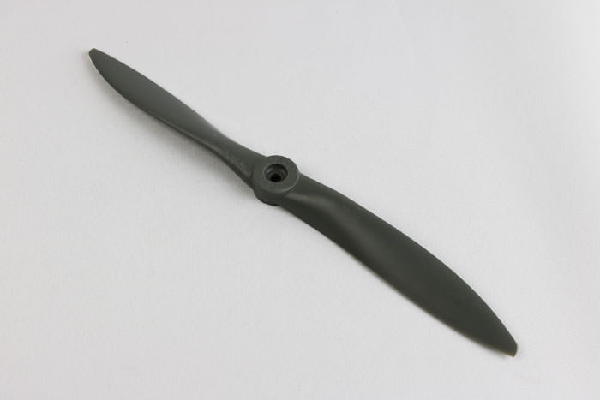
Propulsion - Propeller
Requirement:
Max. rpm = 12,500 rpm
Selected: APC 12x6 Propeller
Diameter | 12 in
Pitch | 6 in
Hub Thickness | 0.48 in
Airfoil section | NACA 4412
Twist distribution | Constant
Chord distribution | Linear

Slide 18
Placeholder: Wiring Diagram

Slide 19
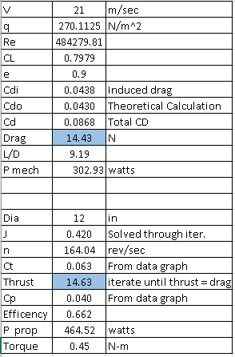
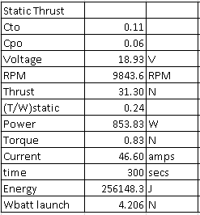
Mothership Performance with Glider
5 minutes flight time with glider:
Required Battery Weight: 4.206N
Voltage: 18.93 VDC
Current: 46.6 A

Slide 20

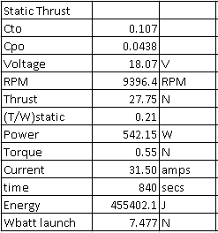
Mothership Performance without Glider
14 minutes powered flight time with glider:
Required Battery Weight: 7.477 N
Voltage: 18.07 VDC
Current: 31.5 A
OVERALL MISSION:
Max Voltage < 22.2 VDC
Max Current < 70 A
Max Weight ≈ 11.65 N

Slide 21
Placeholder: Cost Analysis

Slide 22
Placeholder: Build Plan

Slide 23
Placeholder: Test Plan

Slide 24
Remaining problems and solution plans
Resize wing
Determine how to connect sections of wing together
Recalculate battery size
More accurately size servos for flaperons

Slide 25
Conclusion
Moving forward:
General Layout is Final
Ready to start building after final analysis

